Slide 1

Crowd funding
Presented by Group 1
1.Priya Pramod Dakhore
2.Mrs. Arpita Vipul Naik
3.Amita Mishra
4.Prerna Pyarelal Patil
5.Spoorthi H T
6.Ashish Patil
7.Nazeema Shaik

Slide 2
Presentation Overview
1.Project Overview-Database Description
2.Yearly Project trends by states
3.Percentage of Successful Projects overall
4. Percentage of Successful projects by Goal Range
5.CATGORIES OF PROJECTS
6.Top 3 Projects based on Category
7. Top 3 category wise amount raised
8.Top 3 Backers with Amount Raised
9.Total Number of Projects based on Locations
10.State wise amount raised
11.Avg number of days of successful project
12.Overall total number of projects
13.Dashboards
I. Excel
ii. Power BI
iii. Tableau
14.SQL Queries
15.Summery
16.Challenges

Slide 5
Project Overview
Kickstarter is popular platform where people raise money for their projects. By analyzing Kickstarter data, we can learn
What makes a campaign successful.
We look at the things like how much money was raised , How many people supported it , and type of project
This helps us to find patterns and predict which campaigns might do well .Overall ,it gives creators tips on how to improve their chances of success
Database Description
The Kickstarter dataset contains detailed information about various crowd funding campaigns .it includes fields
like
Project Id | Goal amount | Status of project Success or failure
Category Id | Project Name | Launch Date
Location Id | Pledged Amount | Deadline date
Category | Number of Backers | Country of origin

Slide 6
YEAR WISE TRENDS IN PROJECTS
Over the past six years, there has been a significant decline in the number of projects, with 2014 standing out as the year with the highest project count.
This decline is notable and suggests that various factors, such as market saturation, changes in platforms, or shifts in industry trends, may have influenced the drop in projects over time.

Slide 7



STATE OF PROJECTS
Failed
The project did not reach its funding goal within the specified timeframe, so it did not receive the funds.
Successful
The project met or exceeded its funding goal, and it successfully secured the pledged funds.
Canceled
The project was canceled by the creator before the funding period ended, meaning it was voluntarily halted, and no funds were collected.
Purged, Suspended, and Live—each representing only 1% of the total data—these are less common project statuses.

Slide 8
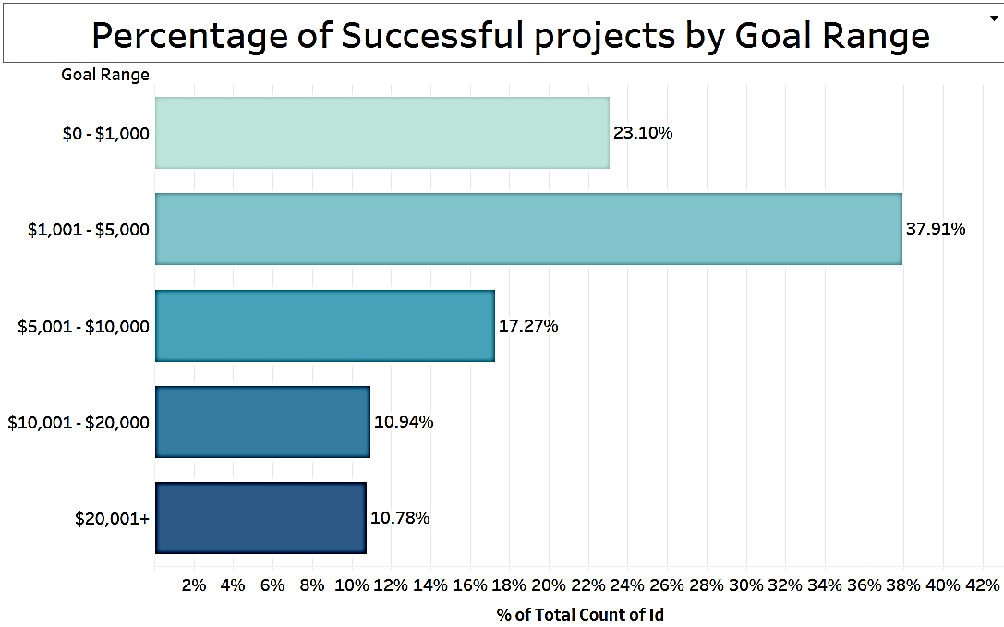
Percentage of Successful projects by Goal Range
“This chart shows the distribution of successful projects across different goal ranges. As we can see, projects with goals between $1,001 - $5,000 have the highest success rate at 37.91%, followed by the $5,001 - $10,000 range at 23.10% .”
Recommendation: For future crowdfunding
campaigns, it’s advisable to set a goal within the
$1,001 - $5,000 range to maximize the chances of
success.

Slide 9
CATGORIES OF PROJECTS
These insights into the popularity of Product Design, Tabletop Games, and Music provide actionable data that can help platforms, creators, and investors better navigate the crowdfunding landscape. It allows for smarter resource allocation, targeted marketing, competitive differentiation, and the creation of supportive communities, all of which contribute to improving the success rates of projects within these top categories.
These insights into the popularity of Product Design, Tabletop Games, and Music provide actionable data that can help platforms, creators, and investors better navigate the crowdfunding landscape. It allows for smarter resource allocation, targeted marketing, competitive differentiation, and the creation of supportive communities, all of which contribute to improving the success rates of projects within these top categories.
28%
Product Design
19%
Tabletop Games
17%
Music

Slide 10
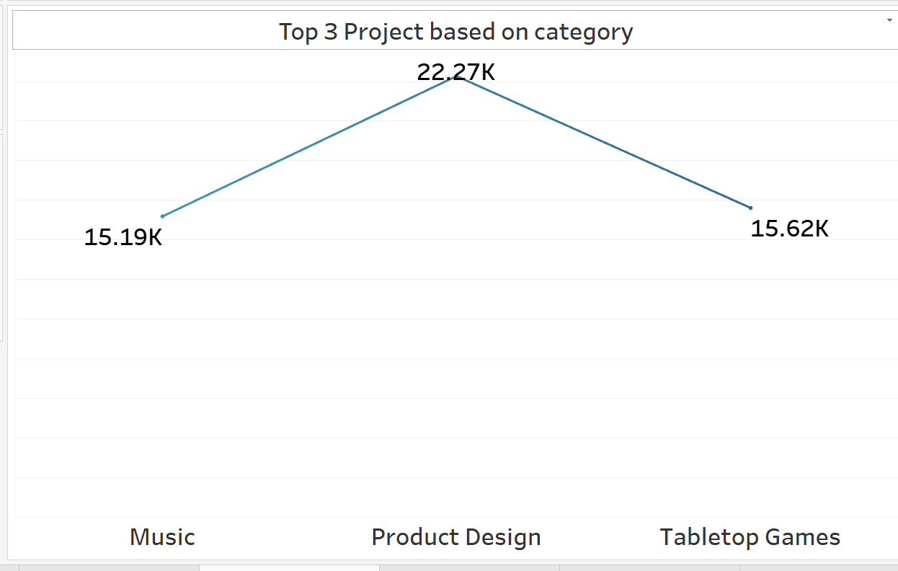
Top 3 Projects based on Category
Highlighting the top 3 categories helps to identify which types of projects are most popular or successful on the platform.
For platform owners or administrators, knowing the top categories can guide where to allocate resources like marketing efforts, platform features, and creators support to maximize impact.
Analyzing the top 3 categories allows stakeholders to understand current trend in the crowdfunding.

Slide 11
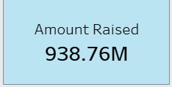
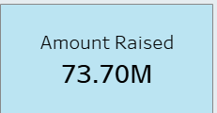

Top 3 category wise amount raised
Product Design
It shows which categories are not just popular in terms of number of project but also generate most funding.
It highlights categories that consistently raised large amounts, showing where there’s significant interest and financial traction.
The KPI card helps to analyze the trends in funding over a time, offering insights into how the financial landscape evolves across the categories.
Knowing which categories raised most funding can help prioritize resources- such as additional platform features or incentives for creators in this high performing area leading to more success and platform growth.
Music
Tabletop Games

Slide 12
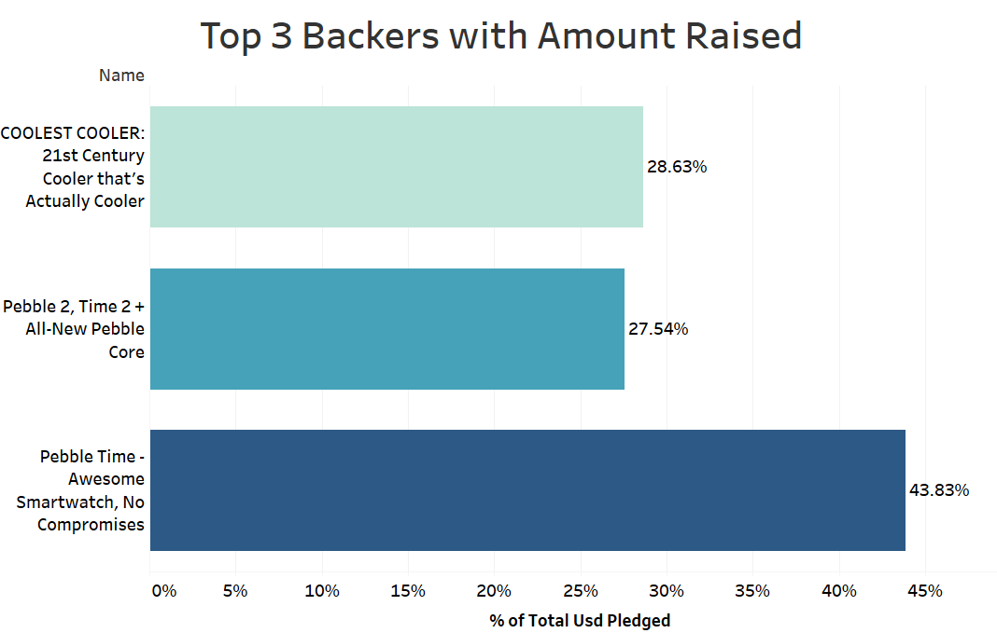
Top 3 Backers with Amount Raised
This chart highlights the top three projects based on the amount raised. The top project, Pebble Time – Awesome Smartwatch, raised 43.83% of the total pledged amount, while the next two projects, pebble and COOLEST COOLER, accounted for 27.54% and 28.63% respectively.”
Recommendation: Identifying the unique features
Or marketing strategies behind these top projects
Could provide insights for future campaigns
aiming to maximize pledges.

Slide 14
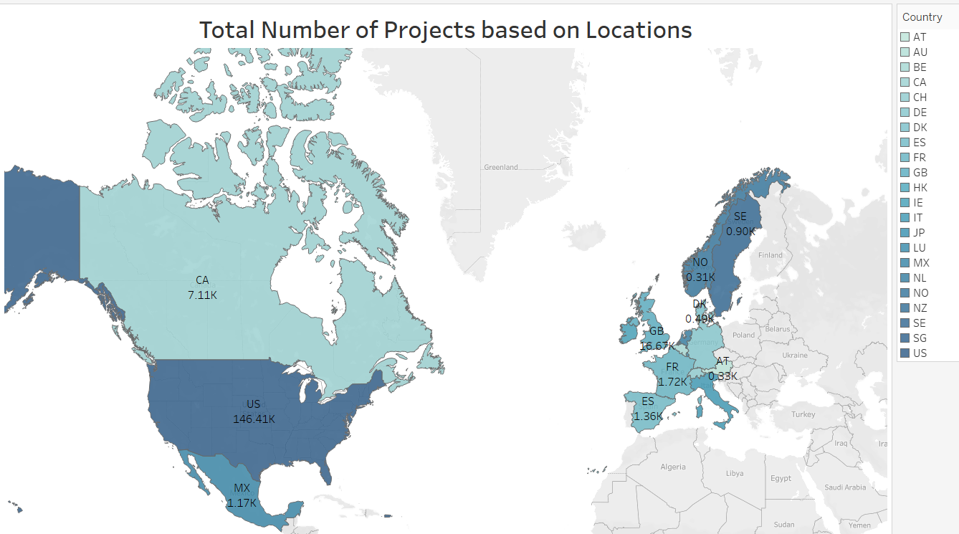
Total Number of Projects based on Locations
This can reveal where the platform is most popular and where growth opportunities exist, helping to understand geographic trends.
For platform owners, Knowing which location have fewer projects can highlight untapped market.
Platform can use location data to allocate resources efficiently.
It can help to creators or marketers to understand where to target potential
Backers.
Showing the distribution of projects by location highlights the platforms global reach and diversity.

Slide 15
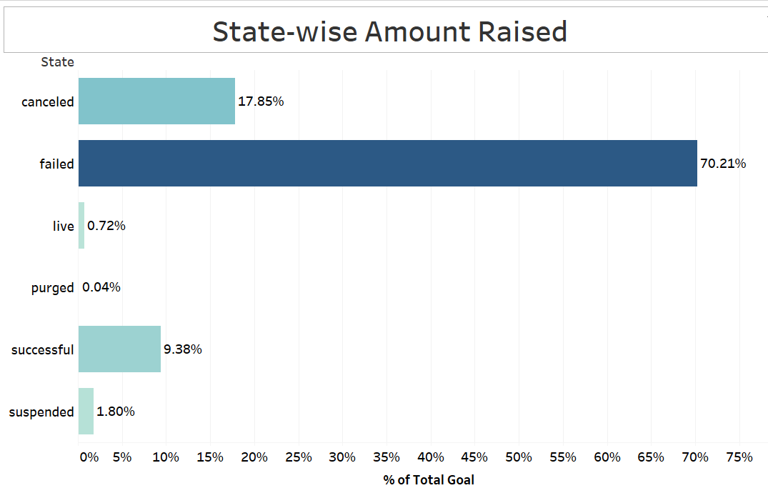
State-Wise Amount Raised
“This chart breaks down the percentage of the total goal amount raised by the state by the state of the projects. A significant portion , about 70.21%, have not to reach their funding goals.”
Only 9.38% of the total amount was raised by successful projects, highlighting the difficulty in achieving project success on the platform” .
Recommendation : It may be worth investigating why
Such a high percentage of project loss .Improved project
Planning, marketing efforts, or goal – setting strategies
Could help increase success rates.

Slide 16
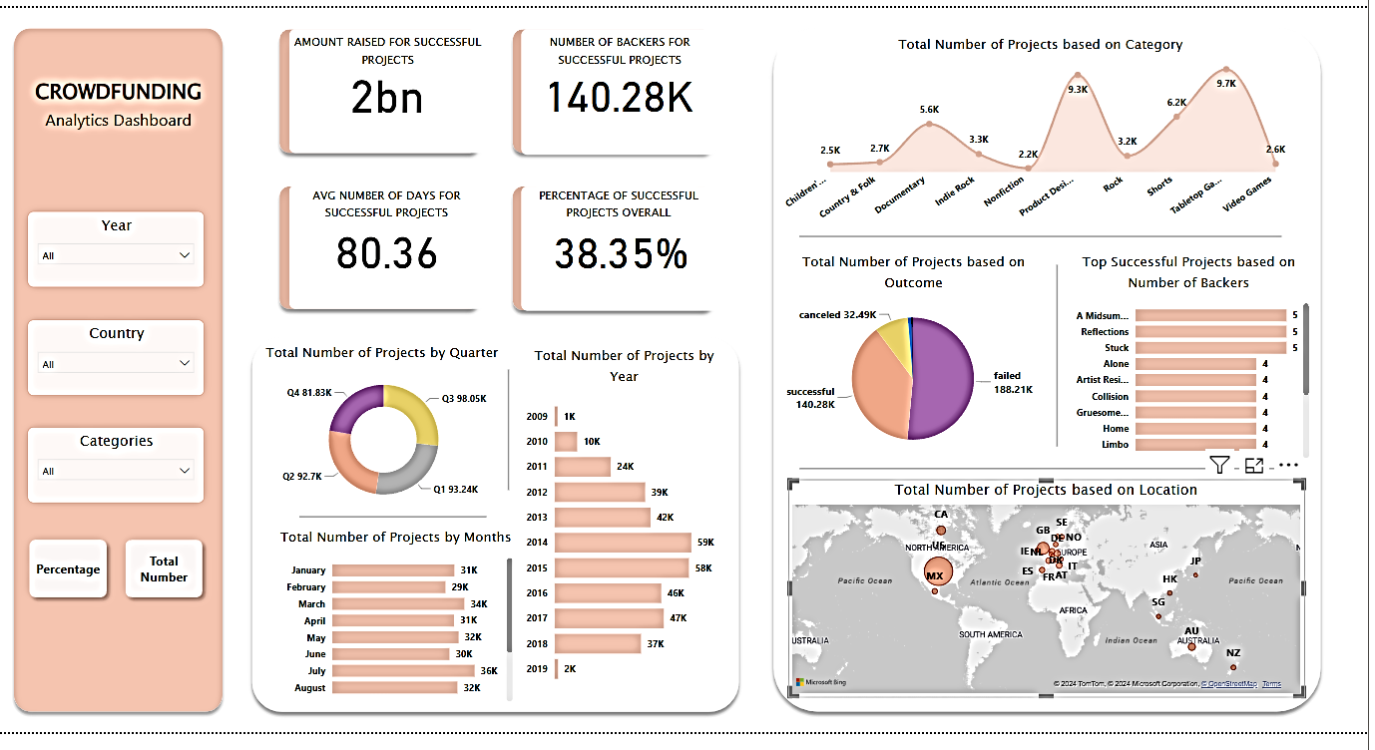
Data Visualization with Power BI

Slide 17
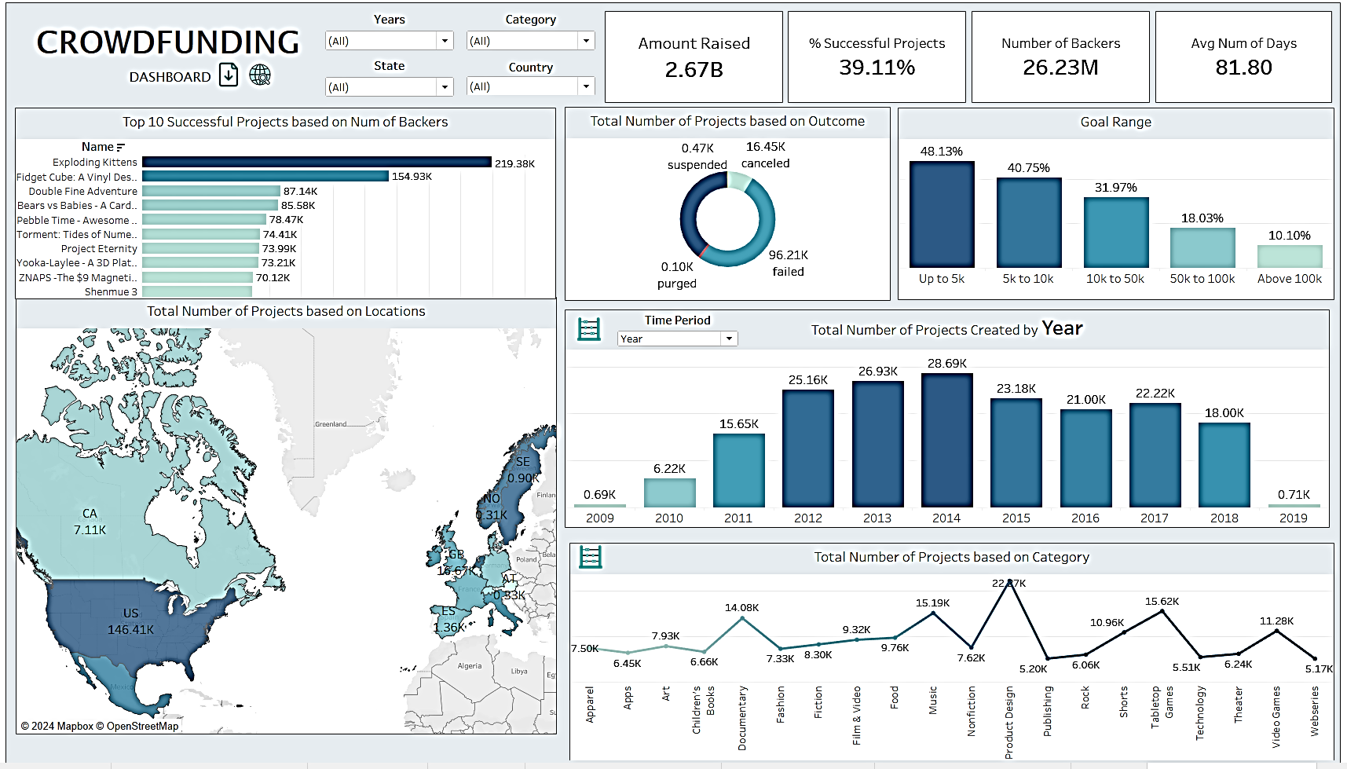
Data visualization by Tableau

Slide 18
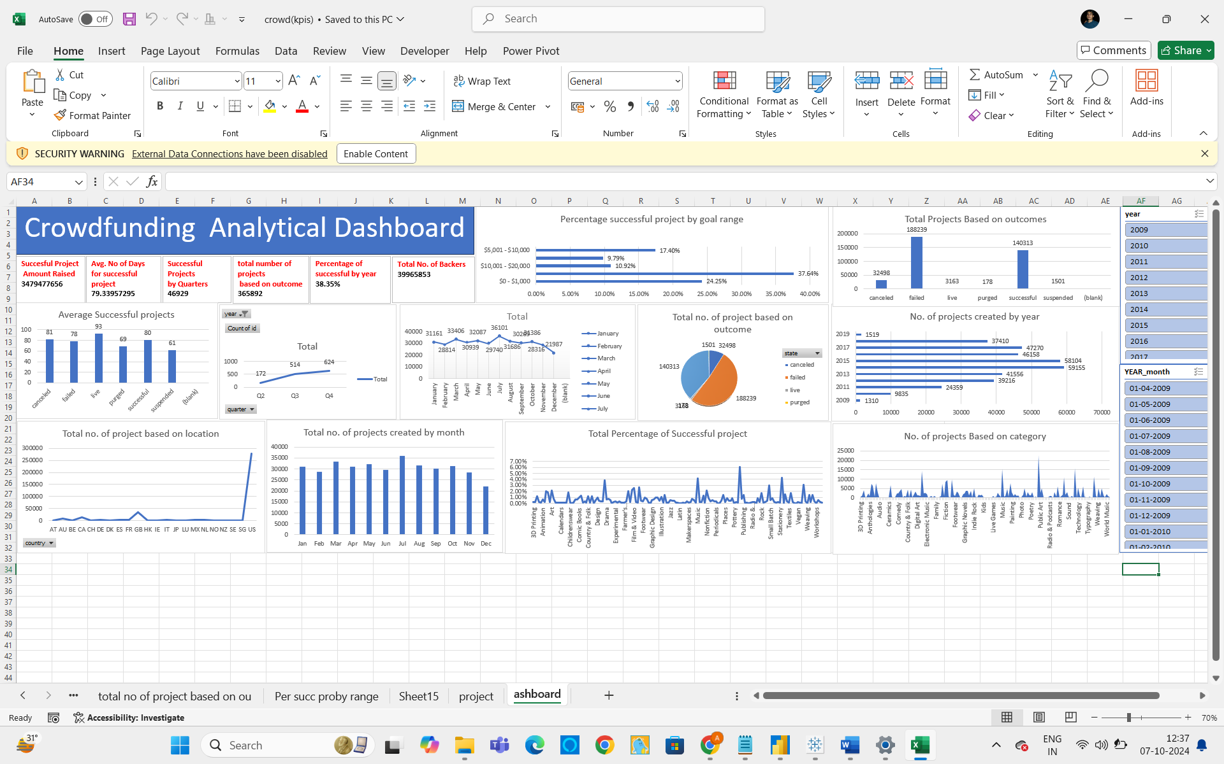
Data visualization by Excel
Total number of projects by month
Total no of projects by quarter

Slide 19
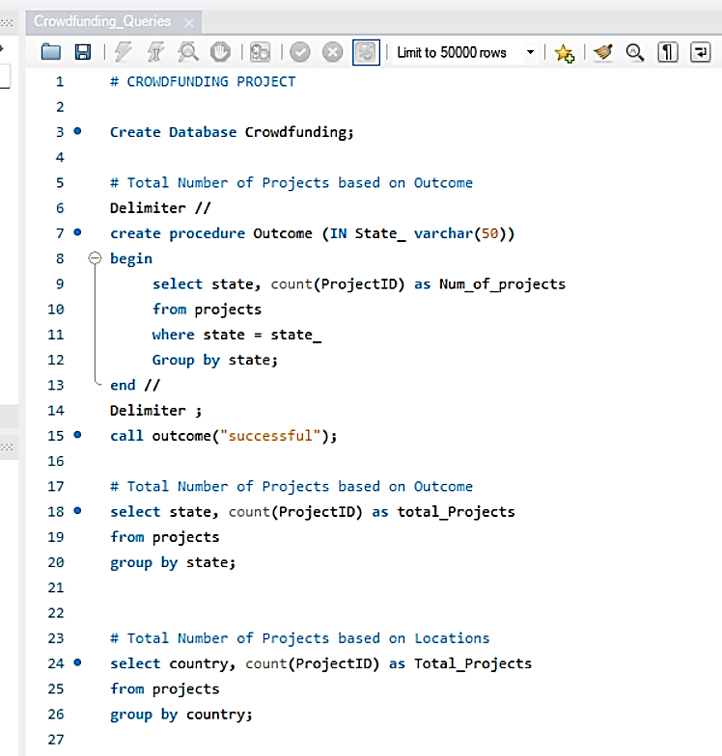
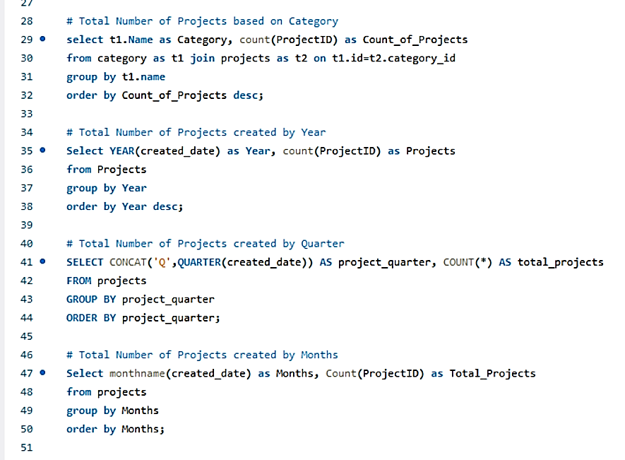
SQL QUERIES

Slide 20
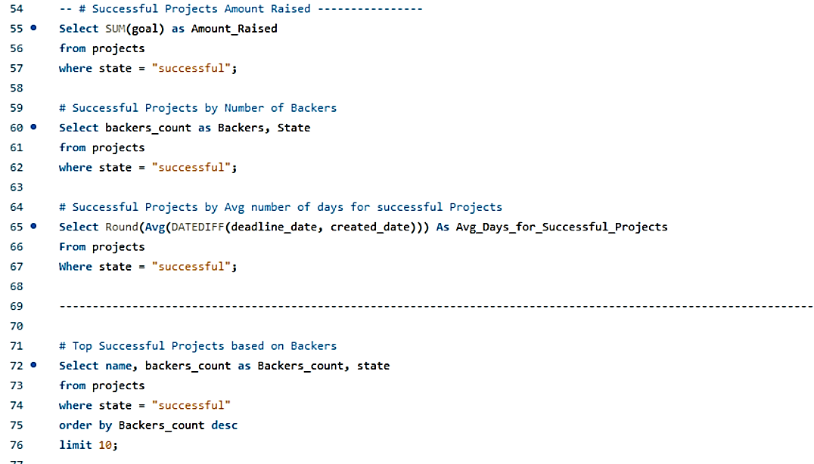
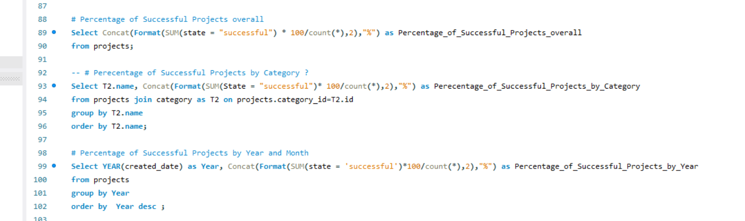
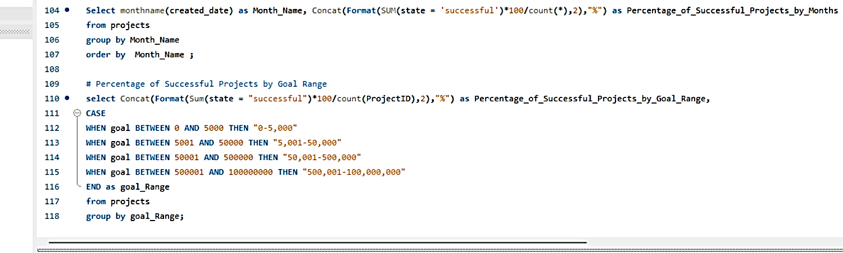

Slide 21

The crowdfunding dashboard provides a comprehensive overview of key project metrics, highlighting the total amount raised, success rates, and the number of backers. Overall, the platform has raised an impressive $2.67 billion, with 39.11% of projects achieving successful outcomes, supported by a total of 26.23 million backers. The average duration of these projects was around 81.8 days. Notably, top projects, such as Exploding Kittens with 219.93K backers, and Fidget Cube with 154.93K backers, stand out as some of the most successful campaigns.
In terms of project outcomes, the majority of projects encountered failure, with 96.21K failing to reach their goals, 16.45 K being canceled, and 0.47K being suspended. Interestingly, only a small fraction of projects (0.10K) were purged. Most campaigns aimed for modest funding, with 48.13% of projects raising up to $5K and 40.75% raising between $5K and $10K. Larger funding goals were less common, with only 10.10% of projects exceeding $100K.
Geographically, the United States dominates the crowdfunding landscape, with 146.41K projects launched, followed by Canada with 7.11K. The distribution of projects over time shows a peak in 2013 and 2014, where project creation surged to 25K–28K annually. However, the numbers declined in subsequent years, stabilizing around 21K–23K projects per year. The data also reveals interesting insights into the types of projects being funded, with the most popular categories including Games (22.7K projects), Technology (15.6K), and Music (15.19K).

Slide 22
Challenges
Challenge : Excel was too slow the data when working with large amount of data.
what we did: We moved the data to MYSQL for better storage and used power and , Tableau to
make faster and more interactive charts.
Challenge :The dashboard was slow because of complicated calculations in power BI
What we did: we simplified the calculations and prepared the data MYSQL to make the dashboard load faster
Challenge :Handling Missing data some records in my data or data set had missing dates, which could affect the
accuracy of the analysis.
what we did: To fix this , we filled the missing date fields with a common reference date , ensuring consistency, across
the data sets for further analysis.
Challenge: we faced an issue while importing data into MYSQL due to the format inconsistencies or large file sizes
what we did : we resolved this by cleaning data in excel first , ensuring consistent data formats, and then successfully
imported the corrected data in MYSQL.
Challenge : The dates in our data set had inconsistent formats , making it difficult to analyse timelines accurately
What we did: we standardize the date by converting them into consistent formula(date/86400) , then transformed them
into proper date formats for accurate analysis.

Slide 23

For your attention…………

